Slide 1
SMALL AND MIGHTY: PEPTIDE HORMONES IN PLANT BIOLOGY
By
Sonali Roy, Peter K. Lundquist, Michael K. Udvardi, and Wolf-Rüdiger Scheible

Slide 2
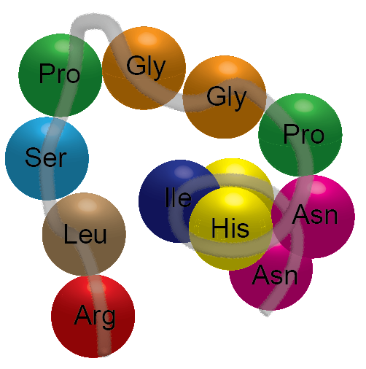
Outline
Introduction to peptide hormones
Structure and generation of peptide hormones
Post-translational modifications and their presumed roles
Prediction and identification of peptide hormones
Mobility and perception of peptide hormones
Physiological roles of peptide hormones
The evolution of peptide hormones
Critical questions in peptide hormone field
Applications in biotechnology
Appendix: Peptide gene families

Slide 3
PART 1
Introduction to peptide hormones

Slide 4
What is a peptide hormone?
5-60 amino acid residues
Serve as receptor ligands
Influence many developmental programs
Active at very low concentrations

Slide 5
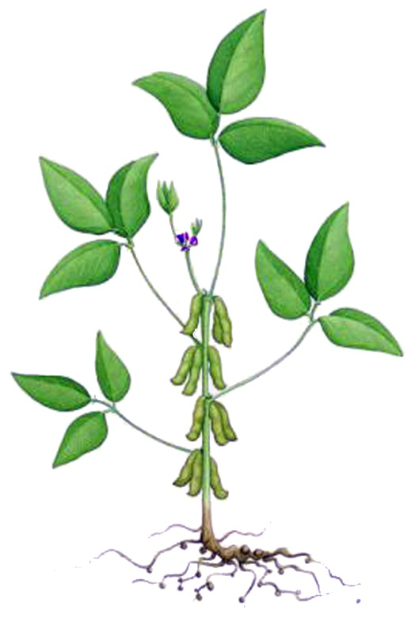
Peptide hormones control various developmental programs
Shoot development
Meristem maintenance
Cell division and expansion
Plant height
Biosynthesis of alkaloids
Vascular differentiation
Inflorescence development
Inflorescence distribution
Floral organ abscission
Pollen tube germination, growth and guidance to ovule
Stigma exudate deposition
Self-incompatability determinant
Fruit shape
Leaf development
Stomatal patterning and distribution
Density of guard cells
Leaf shape
Leaf vascularization
Seed and seed-pod development
Early and late embryo patterning
Nutrient translocation in seeds
Response to biotic stresses
Immune system and defense against pathogens
Associations with beneficial microorganisms
Protection against herbivory
Root development
Lateral root formation
Meristem maintenance
Gravitropism
Root hair growth
Casparian strip formation
Vascular differentiation
Response to abiotic stresses
Nitrogen, phosphorus limitation
Stomatal control of transpiration

Slide 6
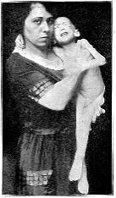
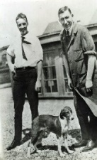
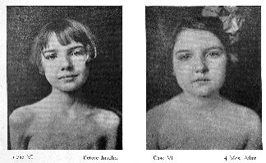
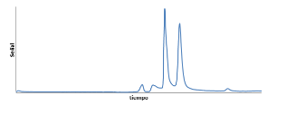
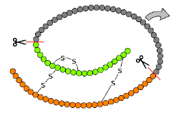
Systemin was the first known plant peptide hormone
‘Isletin’ or insulin was the first known peptide hormone
The first known plant peptide hormone was named systemin
1889- Mering and Minkowski noted that removal of pancreas resulted in total diabetes in dogs.
Wounding or insect damage
1972 T. Green and C. A. Ryan noticed leaf wounding caused accumulation of proteinase inhibitors in wounded and distal unwounded leaves.
Concluded that a mobile factor systemically signals the plant that it is under attack.
A boy with untreated severe diabetes.
1921- Banting and Best hypothesized that Islets of Langerhans in the pancreas produced an internal secretion that controlled blood sugar levels.
1922- Extracted highly pure insulin and treated patients (with J. Collips, J. Macleod).
Fredrick Banting and Charles Best
Inhibitors in unwounded leaves
1926- John J. Abel crystallized insulin and found that it tested positive for the Biuret reaction, a test for proteins.
HPLC chromatogram
1991 Gregory Pearce isolated the first peptide hormone
Called it systemin,
18 amino acid long
¹⁴C labelled synthetic systemin was mobile
Active at 40 femtomolar!
Before & After insulin treatment
1951, 1952- Frederick Sanger identified the amino acid sequence of chain A (21 aa) and chain B (30aa) of the dipeptide Insulin.
Structure of the insulin dipeptide
1980- Graeme I. Bell cloned the human INSULIN gene commenting that it “consists of 3 exons and 2 introns coding for a signal peptide, a B-chain, a C-peptide, and an A-chain."
Purify
Human INSULIN gene structure

Slide 7
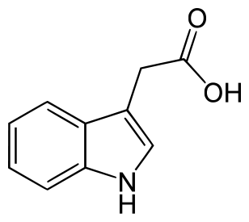
Peptide hormones share many characteristics of classical plant hormones
Small molecule hormones
Peptide
hormones
Similarities
Regulate growth and development even at minute concentrations
Can act long distance
Commonly require membrane receptors for recognition
Activity may require secondary group modifications (e.g., hydroxylation)
Chemical Structure- Derived from amino acids (e.g., Indole-3-acetic acid), isoprenoids (e.g., Benzyl amino purine), lipids (e.g., Methyl Jasmonate)
Biosynthesis- End products of a cellular metabolic pathway
Chemical Structure- Derived from polypeptide chains
Biosynthesis- Transcribed ribosomally from a single gene
Y
I
Y
T
N
SO₄
SO₄
Phytosulfokine peptide
Auxin (IAA)

Slide 8
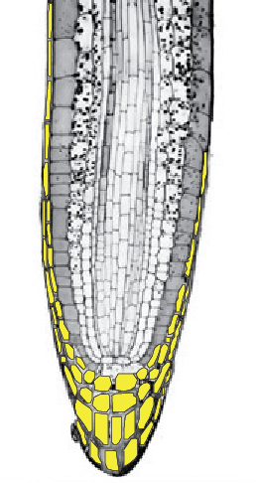
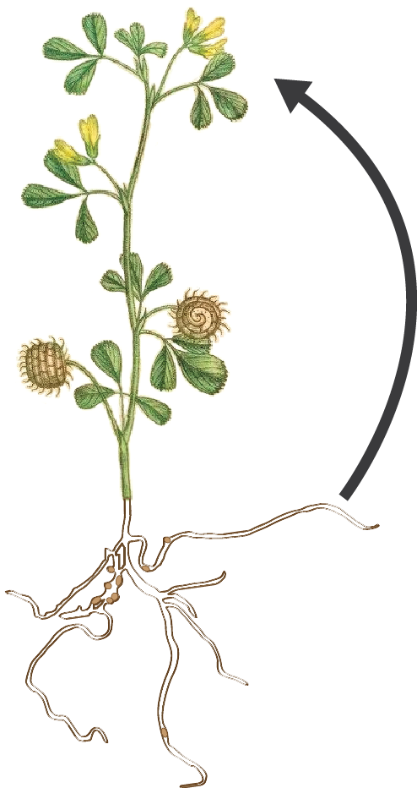
Peptide hormones can act over short and long distances
Cell-to-cell communication (Short distances)
Organ-to-organ communication
(Long distances)
Example: In Legumes, members of the CLE family in roots signal to shoots when they have enough nitrogen-fixing organs!
Example: Yellow cells indicate specific cells of the root tip in which the peptide CLE40 is expressed.
SYMPLAST
APOPLAST
Image source: Root tip Modified from ?, Self

Slide 9
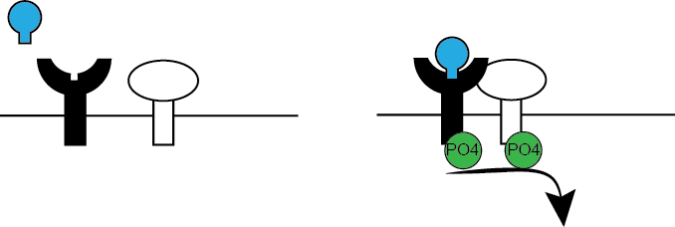
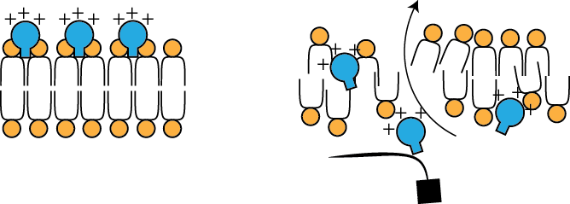
Peptides can perform different functions
But not all peptides are hormones!
FREE
PEPTIDE
BOUND PEPTIDE
1. Can act as Signals
ACTIVE COMPLEX
e.g., CLE peptides
RECEPTOR
Co-RECEPTOR
SIGNAL
RELAY
PLANT PLASMA MEMBRANE
OUTSIDE
2. Can be anti-microbial
INSIDE
e.g., Defensins prevent infection
BLOCK
TRANSLATION
LEAKAGE OF IONS
MICROBIAL MEMBRANE
PEPTIDE-BOND CLEAVAGE
NO CLEAVAGE
3. Can inhibit peptidases
Hasn’t been studied in plants to date!
FUNCTIONAL PROTEIN
COMPETETIVELY BINDS TO ACTIVE SITE
INTRACELLULAR COMPARTMENTS

Slide 10
PART 2 Structure and generation of peptide hormones

Slide 11
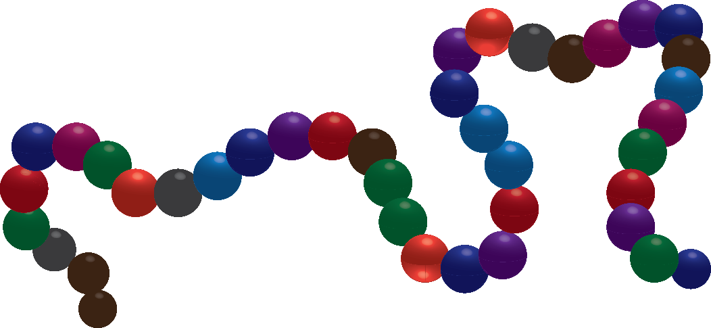
Anatomy of a small signaling peptide
Two major criteria are used to classify plant peptides
(1) Primary sequence characteristics
(2) Post-translational modifications
N-TERMINAL SIGNAL PEPTIDE
VARIABLE REGION
C-TERMINAL SIGNALLING PEPTIDE
Directed to the endoplasmic reticulum, Golgi secretory pathway
5-60 amino acids long
May contain different post-translational modifications

Slide 12
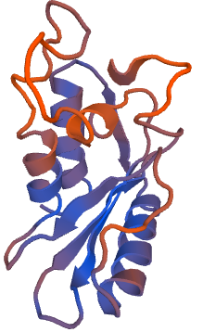
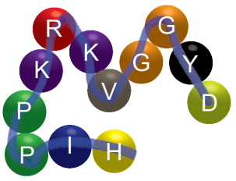
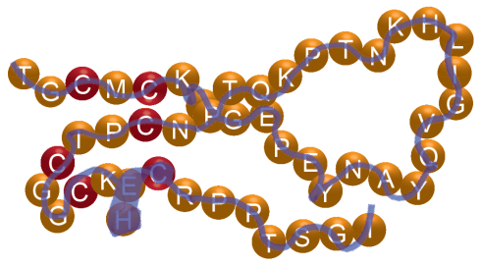
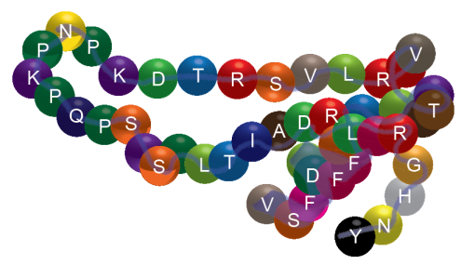
Peptide hormones are classified into families
Does the precursor itself perform a function?
YES
YES
NO
Peptide has a different function
Functional precursor
Does the peptide have any post-translational modifications?
YES
FUNCTIONAL-PRECURSOR DERIVED PEPTIDES
(Tyrosine) Can be sulphated
Is the peptide derived from a single ribosomally translated precursor?
NO
(Proline) Can be hydroxylated, glycosylated
POST-TRANSLATIONALLY MODIFIED PEPTIDES
Does the peptide have four or more cysteines?
YES
Di-sulphide bridges form between cysteines
NO
CYSTEINE-RICH PEPTIDES
NO
NONPRECURSOR DERIVED
UNMODIFIED PEPTIDES
5’ region
of mRNA
Pri-miRNA
Short ORF
See Tavormina, P., De Coninck, B., Nikonorova, N., De Smet, I., and Cammue, B.P.A. (2015). The Plant Peptidome: An expanding repertoire of structural features and biological functions. Plant Cell 27: 2095–2118.

Slide 13
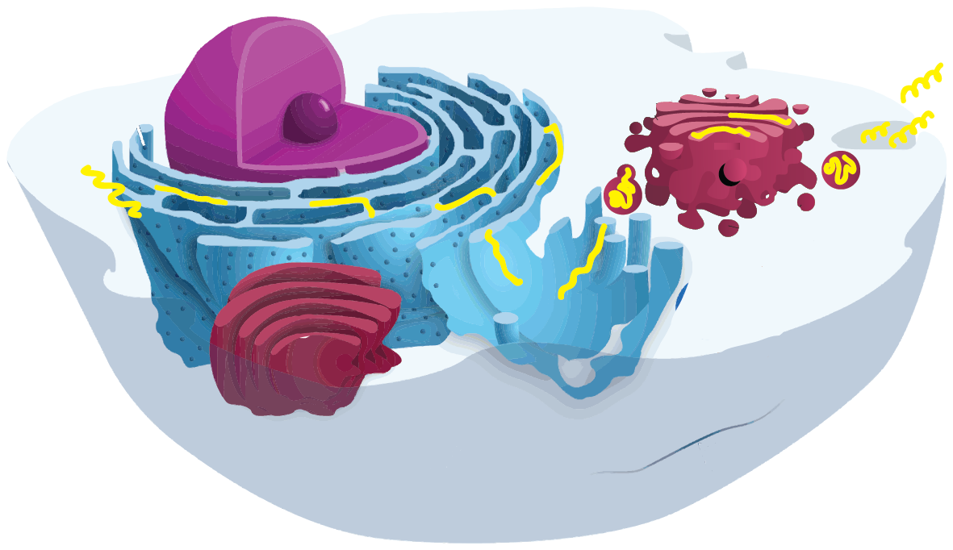
Mature peptides are processed from longer precursors
NUCLEUS
ENDOPLASMIC
RETICULUM
GOLGI
APPARATUS
Pre-Pro-Peptide
mRNA
translation
Peptide
Pro-Peptide
Pre-pro-peptide
Precursor of pro-peptide
Biologically active peptide
Inactive peptide
Image source: Modified from Wikipedia

Slide 14
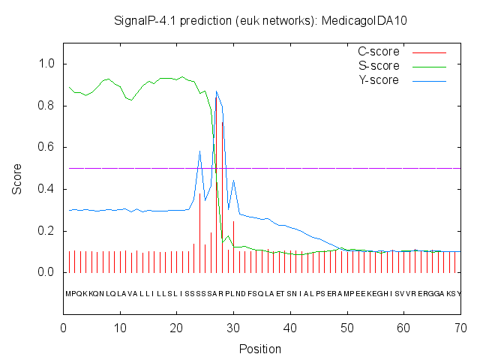
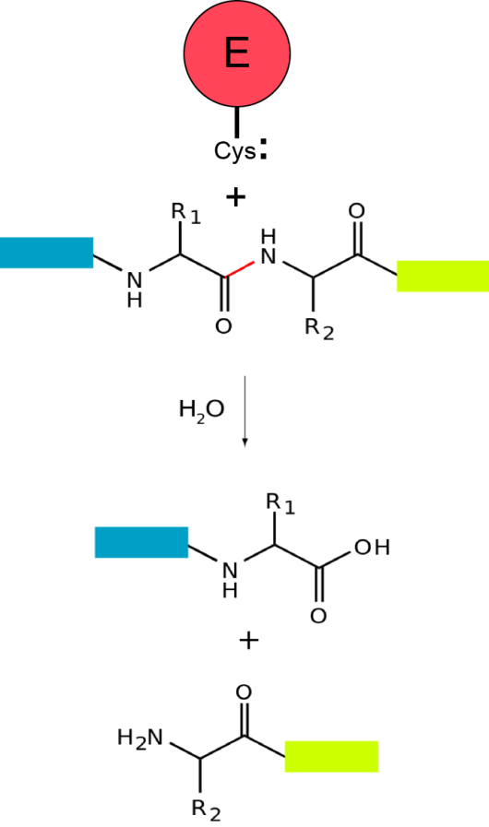
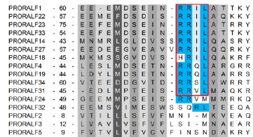
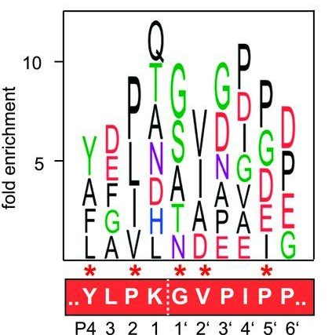
Peptide processing precedes peptide activity
Signal-peptide peptidases remove N-terminal signals
Peptide cleavage occurs at specific motifs
Release of signalling peptide requires special enzymes
Peptidase cleavage site (RxxL/RxLX)
Peptidases (molecular scissors)
Scissile Bond
Cleavage occurs at specific motifs.
C Score: Highest score at position immediately after the cleavage site
S Score: High score distinguishes proteins with signal peptide from those without
What do the D score and Y score indicate? Follow the link
http://www.cbs.dtu.dk/services/SignalP-4.1/
Peptidases/proteases/proteinases can belong to different families depending on the amino acid residue that becomes nucleophilic and cleaves the peptide bond.
Both upstream and downstream motifs can contribute to site recognition.
Stegmann, M., et al. , and Zipfel, C. (2017). The receptor kinase FER is a RALF-regulated scaffold controlling plant immune signaling. Science 355: 287–289; Schardon, K.,et tal. and Schaller, A. (2016). Precursor processing for plant peptide hormone maturation by subtilisin-like serine proteinases. Science 354: 1594–1597.

Slide 15
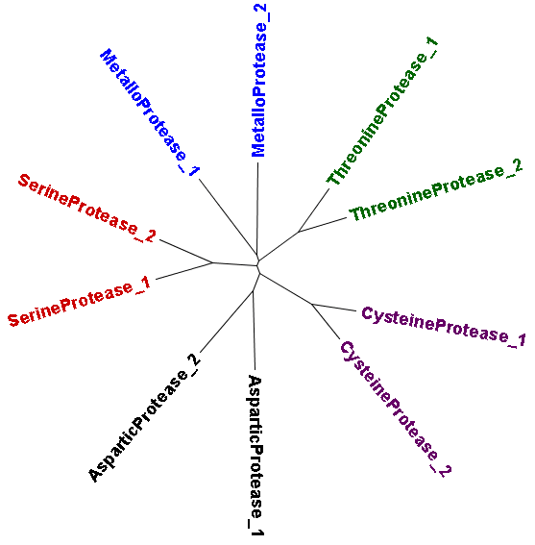
Peptidases can be classified into different families
Based on amino acid involved in the nucleophilic attack on the peptide bond
Based on position of cleavage site
N-terminus
C-terminus
N-terminus
C-terminus
Endopeptidase cleaves the non-terminal amino acids compared to Exopeptidases which hydrolyse terminal peptide bond to release a single amino acid.
N-terminus
C-terminus
N-terminus
C-terminus
Proteases can be classified into families based on sequence homology and the amino acid residue that participates in the nucleophilic acid that cleaves the CONH peptide bond.
Exopeptidases can be further classified as Aminopeptidases and Carboxypeptidases that hydrolyse the peptide bond at the N-terminal and C-terminal end respectively.
Plant proteases can also be involved in protein turnover, degradation of misfolded proteins.
Only a subset of the ~600 proteases in Arabidopsis are involved in the secretory pathway!

Slide 16
Peptide activity requires proteases
1. Functional subtilisin serine protease is essential for peptide activity
35S-AtRALF23
35S-AtRALF23
OVEREXPRESS
OVEREXPRESS
Wild type
Retarded root growth, decreased hypocotyl growth, smaller leaves,
multiple inflorescences
site 1 protease Mutant
Wild type like (no phenotypic effect of RALF overexpression)
2. A purified metacaspase (cysteine protease) can directly cleave a pre-pro-peptide expressed in bacteria
Ab
Ab
AtMETACASPASE9
Wild type
Tag
AtGRIMREAPER
atmetacaspase9
Mutated
Protein
Gel Blot
Tag -AtGRIMREAPER
Protein
Gel Blot
Tag -AtGRIMREAPER
Low
Tag -AtGRIMREAPER
High
Bacterial culture expressing peptide
Bacterial culture expressing peptide
Srivastava, R., Liu, J.-X., Guo, H., Yin, Y., and Howell, S.H. (2009). Regulation and processing of a plant peptide hormone, AtRALF23, in Arabidopsis. Plant J. 59: 930–939. Wrzaczek, M. et al. (2014). GRIM REAPER peptide binds to receptor kinase PRK5 to trigger cell death in Arabidopsis. EMBO J. 34: 55–66.

Slide 17
PART3 Post-translational modifications and their presumed roles

Slide 18
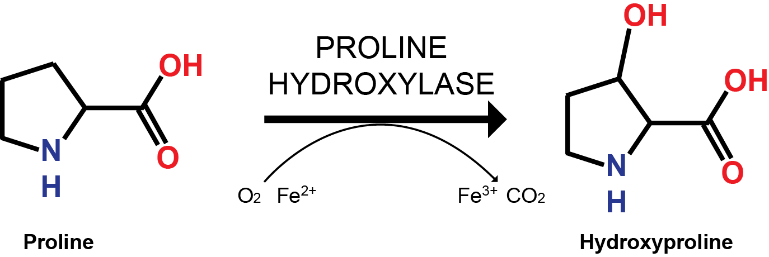
Peptide processing involves post-translational modifications
Can occur non-enzymatically – cysteine (C) disulfide bond formation
This can be due to physio-chemical characteristics of reactive amino acids and the cellular environment (e.g. pH, oxygen etc.) May require chaperones.
May require specific modifying enzymes
(1) Prolyl 4-Hydroxylase
These enzymes have highly tissue specific expression.
Can be responsive to hypoxia, anoxia, mechanical wounding.
(2) Tyrosylprotein sulfotransferase (TPST)
TPST enzymes catalyze the transfer of sulfate to the phenolic group of the tyrosine residue.
Absence of this enzyme results in many developmental defects including shorter roots.

Slide 19
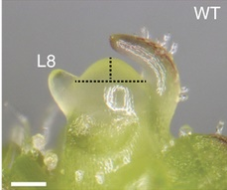
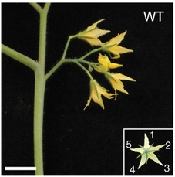
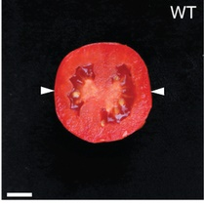
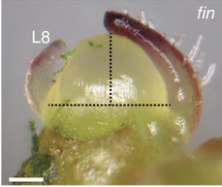
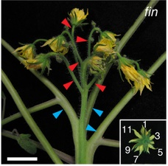
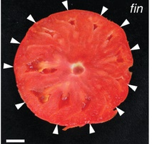
Disruption of post-translational modifications impairs downstream function
Disruption of (hydroxy) proline glycosylation pathway increases meristem size in tomato
Mutants have more than 1.5 times larger shoot meristem with increased floral organ number
Meristem phenotype can be rescued with application of synthetic Arabinosylated CLE peptides
WT (Wild-type Control)
fin (fasciated inflorescence)
Reprinted by permission from Xu, C., et al., and Lippman, Z.B. (2015). A cascade of arabinosyltransferases controls shoot meristem size in tomato. Nat Genet 47: 784-792.

Slide 20
Post-translational modifications are crucial for peptide – receptor interactions
+Peroxidase
Luminol: Chemiluminescent agent - emits light upon excitation
Peroxidase: Oxidizes luminol in the presence of ROS
Amount of peptide required for a ROS Burst
If unmodified peptide is added
33 nM
If a random proline is hydroxylated
33 nM
Highest affinity Interaction between peptide and receptor!!!
If a conserved proline is hydroxylated
1 nM
Butenko, M.A., Wildhagen, M., Albert, M., Jehle, A., Kalbacher, H., Aalen, R.B., and Felix, G. (2014). Tools and strategies to match peptide-ligand receptor pairs. Plant Cell 26:1838-1847.

Slide 21
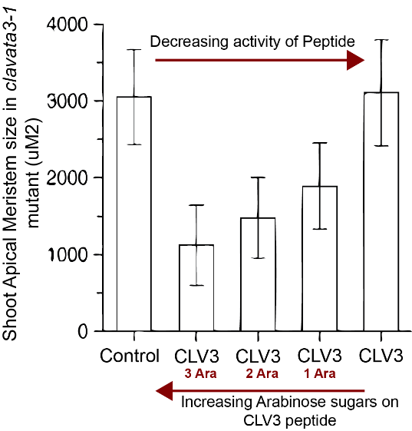
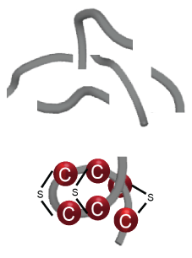
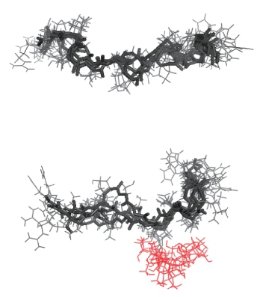
Post-translational modifications contribute to the biological activity of a peptide
PTMs are required for correct conformation
PTMs can protect peptides from proteolytic degradation
+ Protease
C-terminally Cysteine rich peptide
CLV3 peptide
Digested fragments
Induces bending of peptide for stability
+
CLV3 peptide + 3 Arabinose
Protected functional peptide
Arabinosylation affects steric interactions with the peptide backbone
Only the N-terminal cysteine poor regions are digested by processing.
Shinohara, H., and Matsubayashi, Y. (2013). Chemical synthesis of Arabidopsis CLV3 glycopeptide reveals the impact of hydroxyproline arabinosylation on peptide conformation and activity. Plant Cell Physiol 54:369-374.
Notes:
Hydroxylation can make a peptide more soluble.
Addition of Arabinose sugar chains to the hydroxyproline on the CLAVATA3 peptide could increase activity of peptide.
The peptide could restore the shoot apical meristem size in the CLV3-1 mutant which has an increased meristem size.
Molecular modelling could show that the bulky arabinose chain causes a kink in the peptide backbone because of steric repulsion thus probably making it easier to interact with the receptor.
PTMs such as disulfide bridge formations can cause conformations in the peptide backbone that can prevent recognition by proteolytic enzymes.
This can lead to selective degradation of the variable region of the peptide while the signalling peptide remains intact.

Slide 22
PART 4 Prediction and identification of peptide hormones

Slide 23
Three challenges to peptide hormone prediction
Bias against genome prediction of small genes
SSP genes tend to be encoded in short gene products, however genome annotations under-predict or explicitly exclude short gene products, eliminating them from gene lists
Only these longer ORFs are predicted to encode a gene
Sequence conservation is limited to a few critical residues
This family below has no conserved sequence pattern outside of the cysteines that can be used to search for additional genes
Family Member 1 -
Family Member 2 -
Family Member 3 -
Family Member 4 -
*
*
*
*
*
*
*
Rules for processing of a preproprotein are poorly defined
Even when the genes are known it is difficult to determine what part of the gene product encodes the mature, bioactive peptide hormone
Where does the peptidase cut?
Full-length protein sequence
MKLQGITLNIINALFLMIFSFLLLSHSIQVEGTRPLKDQSAPSVISLIINQAYSGPSHKGRGH
Predicted Signal Peptide
HKGRGH
What is the resulting bioactive peptide?
SGPSHKGRGH
NQAYSGPSHKGRGH

Slide 24
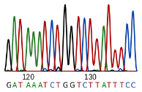
Four complementary approaches to peptide hormone discovery
Discover Peptide Hormone Genes
Bioinformatics
Predicts peptide hormone genes based on sequence patterns
Transcriptomics
Validates expression of small, potential peptide hormone genes in genomes
Biochemistry
Uses chemical tools to isolate and detect peptides directly
Genetics
Tests for peptide hormone genes through genetic or peptide screens

Slide 25
Bioinformatics searches rely on sequence patterns
Prediction of peptide genes by bioinformatics relies on the use of PATTERNS
Patterns characteristic of peptide hormones generally
Patterns unique to each peptide hormone family
Whole genome gene set
70,000 Genes
Specific amino acid sequence motifs
Protein size
30,000 Genes
CLE
family
Predicted signal peptide
Specific cysteine patterns
3,000 Genes
Lack transmembrane domains
GASA
family
Predicted peptide hormone genes
1,000 Genes

Slide 26
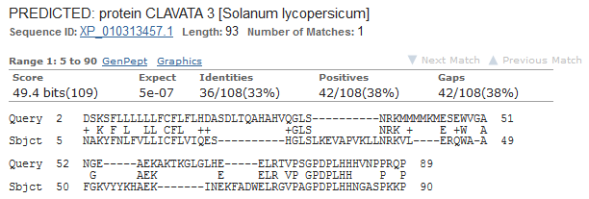
Homology & hidden Markov model searches predict novel peptide hormones
Homology search (BLAST)
Identifies sequences from a database similar to a query sequence-of-interest
Sequences can be amino acid or nucleotide
Homology searches of peptide hormones require especially sensitive algorithms due to the low conservation among homologs
Sequence-of-Interest
Database
Hidden Markov model (HMM) search
Identifies sequences from a database similar to a hidden Markov model (HMM)
An HMM represents a conserved sequence motif of a family
Model can be based on amino acids or nucleotides
Multiple sequence alignment of an peptide hormone family
HMM of same peptide Hormone Family

Slide 27
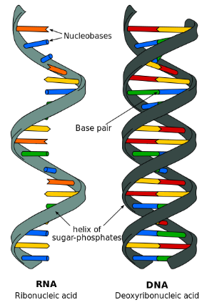
Transcriptomics uses sequencing technology to validate peptide hormone genes
Genome-wide gene expression is captured as mRNA
100s of millions of short sequences are produced randomly across the transcriptome
RNA is converted to DNA
Sequences
5’
3’
5’
3’
AAA
AAA
5’
3’
5’
3’
AAA
5’
3’
AAA
AAA
Genome
(the transcriptome)
By mapping the short sequence reads onto the genome sequence we can see what parts of the genome are expressed
If we predict a short open reading frame encodes an peptide hormone, evidence of expression supports that prediction

Slide 28
Genetic techniques can discover & test for potential novel peptide hormones
Forward genetic screens
Biochemical genetic screens
Reverse genetic screens
1. Develop mutagenized population
1. Select mutant line of putative peptide hormone gene
1. Develop library of synthetic peptides based on putative peptide hormone genes
T-DNA
Peptide
Library
2. Map the causative mutation & gene
2. Search for possible phenotype in the mutant plants
2. Screen the peptides for those giving a phenotype
6 bp deletion

Slide 29
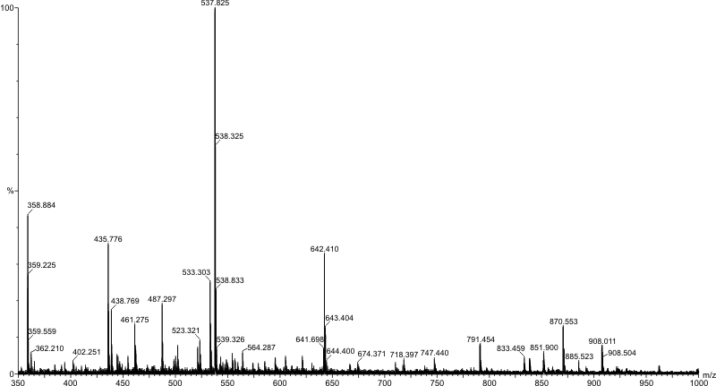
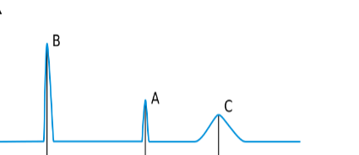
Biochemical methods offer direct detection of peptide hormones
Biochemical Methods Rely on:
Isolation of a Peptide from a diverse mixture of macromolecules, &
Direct Detection of the Peptide, usually by Mass Spectrometry (MS)
Peptidomics: Large-scale, simultaneous analysis of a complex mixture of peptides
Biochemical tools separate out peptides
Identification of peptides by MS
Comparison of two conditions
Untreated
vs.
Treated
Ground tissue
Bioassay Screens: Step-wise purification of a peptide based on a screen for biological activity
Develop/select bioassay
Chromatography steps isolate the peptide
Identification of peptide by MS
Apply mixture and measure:
Root growth
Ca²⁺ spikes
Gene Expression
…….
Collect fraction
Repeat with different chromatographic chemistry
Assay Readout
Time

Slide 30
The cooperative application of these techniques drives discovery of novel peptide hormones
Bioinformatics
Transcriptomics
Discover Peptide Hormone Genes
Advantage: Can predict many SSP genes at a time
Limitation: Must rely on prior knowledge & assumptions. Requires confirmation from the other techniques
Advantage: Supports classification of an ORF as an active, expressed peptide hormone gene
Limitation: Function and activity require confirmation from the other techniques
Biochemistry
Genetics
Advantage: Offers direct detection of a mature peptide and identification of underlying gene
Limitation: Technically difficult to isolate and identify peptides
Advantage: Connects peptide hormone genes to functions & phenotypes
Limitation: Functional redundancy of genes can limit the potential of discovery

Slide 31
PART 5 Mobility & perception of peptide hormones

Slide 32
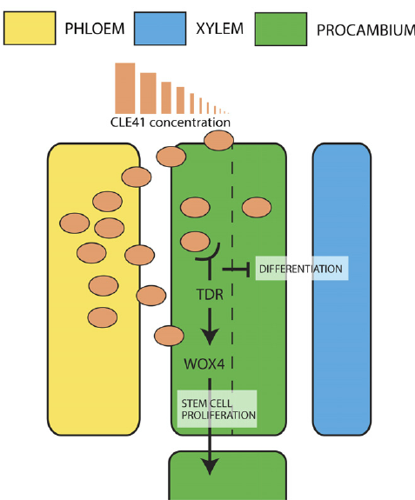
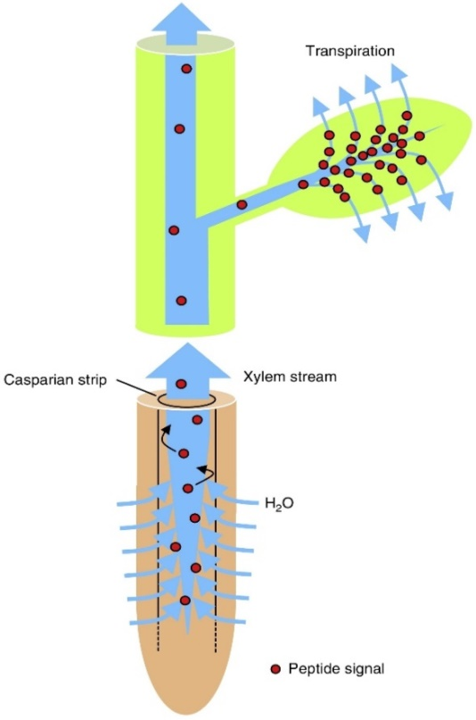
Mechanisms of peptide hormone mobility
Peptide hormone expressed in one cell but receptor expressed in another cell
So … how does a peptide move from its source to its receptor target?
LOCAL
LONG-DISTANCE
Apoplastic diffusion
Xylem stream
Phloem translocation
Shoot-expressed peptide hormones are loaded into the phloem
Phloem-transported peptides can be distributed to the root tissue
Murphy, E., Smith, S., & De Smet, I. (2012). Small signaling peptides in Arabidopsis development: How cells communicate over a short distance. Plant Cell 24: 3198–3217.
Okamoto, S., Tabata, R., and Matsubayashi, Y. (2016). Long-distance peptide signaling essential for nutrient homeostasis in plants. Curr. Opin. Plant Biol. 34: 35–40. with permission.

Slide 33
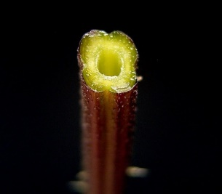
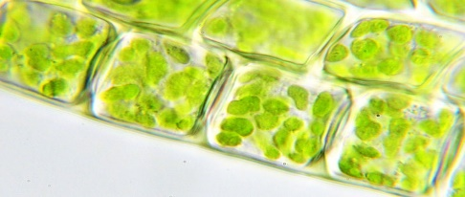
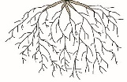
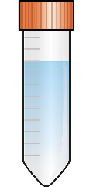
Methods to determine how a peptide is mobilized
Apoplast extraction
Vascular sap extraction
Root–shoot grafting
Tests for:
Presence in apoplastic fluid
Tests for:
Presence in vascular streams
Tests for:
Spatially-segregated expression of receptor/ligand
Wild type
Apoplast: the extracellular space
Mutant
Sap is collected from the stem
Vacuum infiltrate tissue with buffer
Peptides are isolated from the xylem sap by liquid-liquid or solid-phase extraction
Wild type
Root
peptide
mutant
Shoot
receptor
mutant
Isolated peptides are identified by mass spectrometry
Centrifuge tissue to
extract apoplast/buffer mixture

Slide 34
Receptor kinases recognize peptide hormones
Leucine-Rich Repeat Receptor-Like Kinase
(LRR-RLK)
Ectodomain
(Leucine-Rich Repeats)
Extracellular Matrix
(apoplast)
Perceive signal by binding peptide ligand
Transmembrane
Segment
Plasma
Membrane
Convey signal into the cell
Protein Kinase
Cytosol
Initiate intracellular signaling

Slide 35
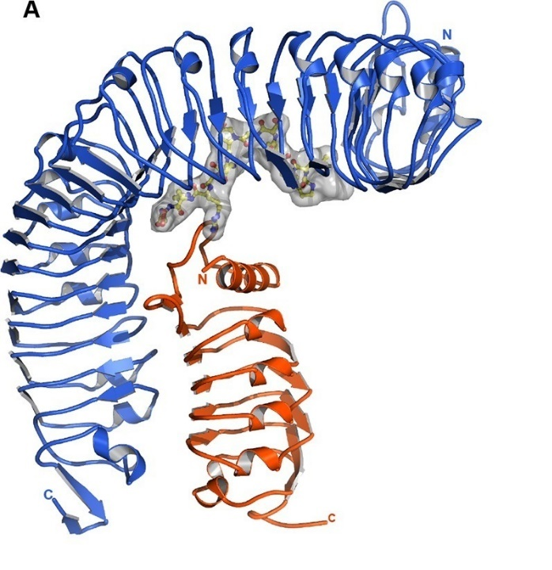
Peptide hormones can be perceived by receptor/co-receptor pairs
Peptide receptors are typically Leucine-Rich Repeat Receptor-Like Kinases
Receptor & co-receptor cooperate to bind the peptide ligand
An IDA peptide in complex with its receptor & co-receptor (only the ectodomains are shown)
Receptor (HAE)
Peptide ligand (IDA)
Co-receptor (SERK1)
Santiago, J., Brandt, B., Wildhagen, M., Hohmann, U., Hothorn, L.A., Butenko, M.A., and Hothorn, M. (2016). Mechanistic insight into a peptide hormone signaling complex mediating floral organ abscission. eLife 5: e15075.

Slide 36
Specific receptor/co-receptor combinations may specify the target ligand recognized
Peptide hormones, receptors & co-receptors are each in multi-gene families providing many possible combinations for interaction
An example from the IDA Family
Does the specific receptor/co-receptor pair determine which ligand to bind?
The A. thaliana IDA family has six members
IDA receptors & co-receptors are also in multi-gene families
Peptide Hormone
IDA
IDA-LIKE 1
IDA-LIKE 2
IDA-LIKE 3
IDA-LIKE 4
IDA-LIKE 5
Receptor
HAESA
HAESA-LIKE 1
HAESA-LIKE 2
Receptor + co-receptor
HAESA + SERK1
IDA
Co-receptor
SERK1
SERK2
SERK3
SERK4
SERK5
HAESA-Like + SERK
IDA-Like
Specificity for a ligand results in distinct downstream effects

Slide 37
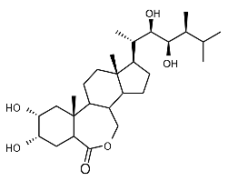
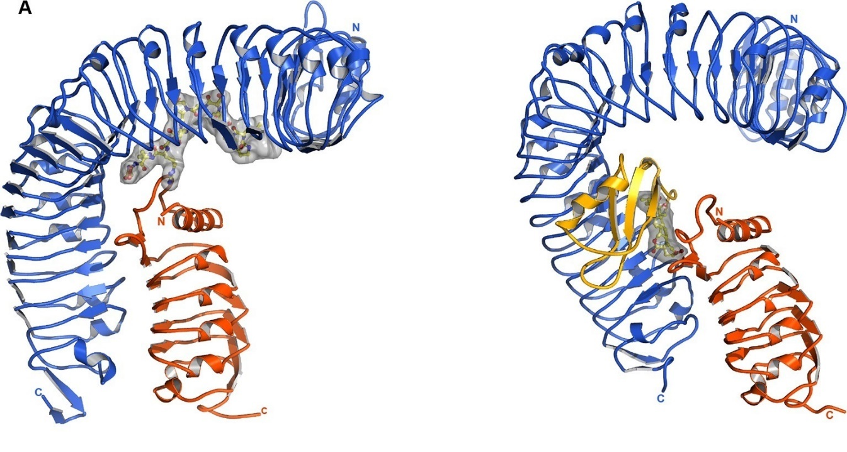
Receptor/co-receptor pairs are also involved in perception of non-peptide hormones
Peptide Hormone
Classical Hormone
IDA Peptide
Brassinolide
OH
G-V-P-I-P-P-S-A-P-S-K-R-H-N
Receptor (HAE)
Co-receptor (SERK1)
Ligand (IDA)
Receptor (BRI1)
Co-receptor (SERK1)
Ligand (Brassinolide)
Santiago, J., Brandt, B., Wildhagen, M., Hohmann, U., Hothorn, L.A., Butenko, M.A., and Hothorn, M. (2016). Mechanistic insight into a peptide hormone signaling complex mediating floral organ abscission. eLife 5: e15075.

Slide 38
IDA peptide signaling activates a MAP kinase cascade for floral organ shedding
Ligand interaction draws receptor/co-receptor together
Trans-phosphorylation
Peptide Hormone
Ectodomain
Transmembrane Domain
Kinase Domain
Ectodomain
Transmembrane Domain
P
P
Kinase Domain
P
P
P
P
Kinase (MKKK)
Repressor
Kinase (MKK)
(BP)
Kinase (MK)
Repressor
(BP)
Promote
Cell Wall Degradation
Adapted from Shi et al. (2011) Arabidopsis Class I KNOTTED-Like Homeobox Proteins Act Downstream in the IDA-HAE/HSL2 Floral Abscission Signaling Pathway Plant Cell 23: 2553-2567

Slide 39
CLE peptides activate distinct signal transduction pathways in different cell types
TDIF
Procambial Cell
Pericycle Cell
Maintenance of procambium (meristem)
P
Lateral root development
KINASE
(BIN2)
Repressor
??
(IAA)
P
Repressor
P
TRANSCR. FACTOR
(WUS)
TRANSCR. FACTOR
(BES1)
(IAA)
TRANSCR. FACTOR
(ARF)
TRANSCR. FACTOR
(ARF)
Promote procambial proliferation
Suppress
xylem
differentiation
Promote
lateral root
initiation
Adapted from Cho, H., et al. and Hwang, I. (2014). A secreted peptide acts on BIN2-mediated phosphorylation of ARFs to potentiate auxin response during lateral root development. Nature Cell Biol. 16: 66-76. and
Kondo, Y., et al. and Fukuda, H. (2014). Plant GSK3 proteins regulate xylem cell differentiation downstream of TDIF–TDR signalling. Nature Comms. 5: 3504.

Slide 40
RALF signaling induces
ROS burst and cell wall alkalinization
Receptor/co-receptor pair constitutively bound
Ligand interaction recruits a cytoplasmic kinase
Trans-phosphorylation
Peptide Hormone
Ectodomain
Transmembrane Domain
Kinase Domain
Ectodomain
GPI Anchor
Cytoplasmic Kinase
P
P
Cell wall
Loosening
H⁺-ATPase
Pollen tube
Rupture
H⁺
RAC
RAC
GEF
P
P
GTP
GDP
P
ROS
O₂
Root hair
Growth
NADPH Oxidase
Adapted from Du, C. et al. (2016). Receptor kinase complex transmits RALF peptide signal to inhibit root growth in Arabidopsis. Proc. Natl. Acad. Sci. USA 113: E8326–E8334.

Slide 41
Signal attenuation is critical for proper peptide hormone function
Endocytosis
Antagonism
Sequestration
Bioactive peptide
Peptide pool
Antagonist
Binds receptor
Blocks binding of bioactive peptide
Protein synthesis
Vacuole
(degradation)
Inactive
Receptor
Active Receptor
Internalization positively regulates signaling
Desensitizes cell by removing receptor & ligand
E.g., triggered by binding of AtPEP1 or EF-TU
Multiple ligands can compete for binding to a receptor
Active ligand blocked from binding and activating the receptor
E.g., EPFL9/EPF2 compete for binding to TMM receptor
Inactive receptors bind and sequester a ligand
Ligand prevented from binding and activating target receptor
E.g., CLE40 is sequestered by ACR4

Slide 42
PART 6
Physiological roles of peptide hormones

Slide 43
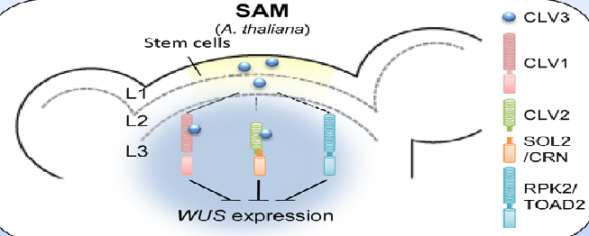
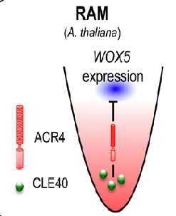
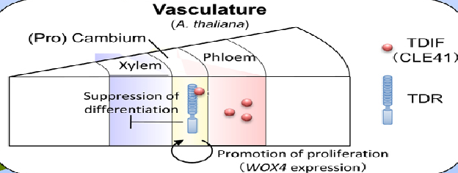
CLE peptides regulate stem cell identity throughout the plant
Betsuyaku, S., Sawa, S., and Yamada, M. (2011). The Function of the CLE Peptides in Plant Development and Plant-Microbe Interactions. The Arabidopsis Book 9: e0149.
Notes:
The Arabidopsis Book

Slide 44
IDA regulates cell separation events through cell wall remodeling & degradation
Floral organ abscission
(FLORAL ORGAN)
(FLORAL ORGAN)
Cell wall degradation in abscission zones
Abscission zone
Abscission zone
(PLANT BODY)
(PLANT BODY)
IDA (ligand)
HAE/HSL2 (receptor)
Lateral root emergence
Cell wall degradation in overlying cells
Lateral root
primordia
Epidermis
Emerging
lateral root
Cortex
Endodermis
Pericycle
Epidermis
Cortex
Endodermis
Image source: FigShare, Flickr
See Aalen, R.B. (2013). Maturing peptides open for communication. J. Exp. Bot. 64: 5231–5235.

Slide 45
Many peptide hormones are floral regulators
Peptide signaling in plant reproduction predominantly relies on the Cys-rich class
Pollen grain
Tapetum differentiation
TPDs
Pollen tube
Self-incompatibility
SCR
Pollen germination
PSKs, STIGs, LAT52/POE
Pollen tube growth
RALFs, STIGs, nsLTPs, PSKs
Pollen tube attraction
LUREs, EALs, PCYs, PSKs
Egg cells
Pollen tube burst
ESs
Egg–sperm fusion
ECA1s

Slide 46
PSKs promote pollen germination
Pollen requires a minimum concentration of granules before they will germinate – this is called the pollen population effect
No germination
Germination
To detect the concentration, pollen grains secrete the peptide hormone PSK, which in sufficient amounts induces germination
See Chen, Y., Matsubayashi, Y., & Sakagami, Y. (2000). Peptide growth factor phytosulfokine-α contributes to the pollen population effect. Planta, 211: 752-755.

Slide 47
Peptide chemoattractants draw pollen tubes to the female gametophyte
Two different peptide families unique to evolutionary groups, each function as chemoatrractant:
LUREs – found in various dicots
EA1s – found in the grasses
Chemotropism: Growth that is navigated by an external chemical stimulus
Pollen grain
Pollen tube receptors sense AtLURE1/ZmEA1 and grow in the direction of the peptide
Pollen tube
AtLURE1/ZmEA1
Ovule
Synergid cells secrete AtLURE1/ZmEA1 peptide diffusing out from the female gametophyte
Female
gametophyte
Peptide concentration gradient
Egg cell
Synergid cells

Slide 48
ES peptides are required for sperm cell release
When the pollen tube reaches the female gametophyte, the sperm cells must be released by pollen tube rupture
In maize, ES (embryo sac) peptides released from the female trigger this rupture
Peptide application induces rapid uptake of potassium and pollen tube swelling
Within seconds of peptide application, pollen tube tips burst, releasing the sperm cells
K⁺
K⁺
K⁺
ES peptide
K⁺
K⁺
Female
gametophyte
Female
gametophyte
Female
gametophyte
See Woriedh, M., Merkl, R., and Dresselhaus, T. (2015). Maize EMBRYO SAC family peptides interact differentially with pollen tubes and fungal cells. J. Exp. Bot. 66: 5205-5216.

Slide 49
Peptide hormones contribute to
abiotic stress tolerance
TEMPERATURE
IDA/IDAL
PIP
DROUGHT/DEHYDRATION
CIF
CLE
Micronutrient deficiency/excess
SULFUR,
IRON
NITROGEN
CEP
CLE
Macronutrient deficiency
PHOSPHORUS
CLE

Slide 50
CIF peptides control permeability of root vasculature
Casparian strip of the cif1cif2 double mutant is discontinuous compared to WT as visualized by the promoterCASP1-GFP reporter fusion.
This defect can be restored by treatment of CIF peptides.
cif1cif2 double mutants are more sensitive to excess iron and are severely stunted with bronzing leaves.
Nakayama, T., Shinohara, H., Tanaka, M., Baba, K., Ogawa-Ohnishi, M., and Matsubayashi, Y. (2017). A peptide hormone required for Casparian strip diffusion barrier formation in Arabidopsis roots. Science 355: 284-286. Reprinted with permission from AAAS.

Slide 51
Peptide hormones have roles in
nitrogen deficiency responses
Changes in root system architecture
Localized modifications of gene expression
Interactions with beneficial soil rhizobia
CEPD
CEP
Sufficient nitrogen
Low
nitrogen
Vector
control
CEP1
overexpression
WT
clv1 mutants
CLE2 overexpression
Induction of nitrate uptake transporters
NRT1.1
NRT2.1
NRT3.1
Induction of mobile CEPs
Overexpression of CEP1 in Medicago enhances production of nodules that house nitrogen-fixing soil rhizobia.
Under low nitrogen conditions, clv1 receptor mutants produce excess lateral roots while overexpression of CLE2 peptides reduce LR number.
Araya, T., et al. (2014). CLE-CLAVATA1 peptide-receptor signaling module regulates the expansion of plant root systems in a nitrogen-dependent manner. Proc Natl Acad Sci U S A 111: 2029-2034.
Tabata, R., et al. (2014). Perception of root-derived peptides by shoot LRR-RKs mediates systemic N-demand signaling. Science 346: 343-346 Reprinted with permission from AAAS
Imin, N., et al. (2013). The peptide-encoding CEP1 gene modulates lateral root and nodule numbers in Medicago truncatula. J Exp Bot 64: 5395-5409 by permission of Oxford University Press .

Slide 52
Peptide hormones contribute to
biotic stress resistance
Plant–herbivore interactions
Plant–bacterial interactions (pathogens)
CAPE
PEP
GASA
RALF
PIP
CLE
CAPE
PEP
GASA
RALF
SYSTEMIN
Plant–nematode interactions
CLE
GASA
Plant–bacterial interactions (symbionts)
NCR
CLE
CEP
PSK
DVL1
Plant–fungal interactions
PIP
GASA
PSK
DEFENSINS

Slide 53
Peptide hormones help mediate interactions with the plant microbiome
Microbiome
Plant associated microbial community that determines the overall health and fitness of the plant and is often defined by host secretions and exudates.
Shoot Microbiome
Rhizosphere
(Plant–root interface)
A gradient in chemical, biological and physical properties which change both radially and longitudinally along the root.
Root Microbiome
Viruses
Nematodes
Fungi
Bacteria
Adapted from McNear Jr., D. H. (2013) The Rhizosphere - Roots, Soil and Everything In Between. Nature Education Knowledge 4(3):1

Slide 54
CLE peptides mediate nodule number control
Medicago receptor mutant sunn (super numeric nodule number) cannot perceive MtCLE12, MtCLE13
MtCLE12 and MtCLE13 are negative regulators of nodule number
Full activity of peptides require the hydroxyproline-O-arabinosyltransferase gene ROOT-DETERMINED NODULATION 1
WT
sunn
Penmetsa, R.V. (2003). Dual Genetic Pathways Controlling Nodule Number in Medicago truncatula. Plant Physiol. 131: 998–1008.

Slide 55
Some microbes produce “mimic” peptides
Ligand
Microbially encoded peptide
Host peptide
Receptor
Microbes encode peptides that share sequence similarity with host peptide hormones. This phenomenon of molecular mimicry is advantageous for pathogens and parasites that can subvert the host immune system and reprogram plant development to promote their own infection.
Activation of downstream signaling cascades

Slide 56
Nematodes secrete CLE peptide mimics that maintain parasitic interactions
‘Syncytia’ cells express the CLE peptide receptors CLV2 and CORYNE
Nematodes secrete CLE peptide mimics
Image Source: Iowa State

Slide 57
PART 7 The evolution of peptide hormones

Slide 58
Peptide hormones frequently appear in gene clusters, allowing neo-functionalization
Duplication of a stretch of the genome is caused by errors during genetic recombination
Peptide hormone
gene cluster
Maintains original function and expression pattern
Develops new expression pattern in different tissue type
Develops binding affinity for different receptor
Such gene duplication is thought to facilitate the rapid evolution seen among peptide-encoding genes

Slide 59
Peptide hormones show high levels of species specificity
Examples of peptide hormone families that emerge at different points along the green plant lineage
Many families develop within specific species or among closely-related species
This indicates recent origin and is consistent with rapid evolution of peptide hormones
CLE Family
Vascular Plants
Peptide Hormone Family | Species
GRIM REAPER (GRI) | Arabidopsis thaliana
Embryo Sac (ES) | Maize (Zea mays)
Nodule Cysteine Rich (NCR) | Sub-clade of legumes
LURE | Various dicots
ns-LTP Family
Seed Plants
IDA Family
Flowering Plants
RALF Family

Slide 60
ES and STIG genes have developed additional species-specific functions
Embryo Sac (ES)
Stigma-specific (STIG)
Maize has developed an extended loop to control pollen tube burst within a larger antimicrobial peptide
Brassica species have developed a short peptide regulating cell death in the upstream region of STIG
Predicted 3-D structure of the ES4 peptide from maize
STIG family is present throughout the angiosperm lineage
Within the Brassicaceae only the preprotein contains an additional peptide hormone with an unrelated function
The predicted structure shows strong structural homology to plant defensins and has been shown to have antifungal activity
Signal peptide
GRI peptide
STIG peptide
Unique to
the Brassicaceae
Present amongst
all angiosperms
However, the red loop is present only in maize and is necessary and sufficient to induce pollen tube rupture
Enhances cell death
Promotes pollen tube growth

Slide 61
The SFTI-1 peptide represents a case of convergent evolution
A short peptide embedded within a larger precursor protein has developed the same 3D structure as the Bowman-Birk Protease Inhibitors
Predicted
evolutionary trajectory
Ancestral gene
Short DNA insertion
Development of Cys-Cys pair
Introduction of loop between Cys and Pro-Pro
Convergence upon BBI
Sunflower Trypsin Inhibitor – 1
Present in sunflower and closely related species
Bowman-Birk Protease Inhibitors
Present in legumes and grasses
Elliott, A.G. et al. (2014). Evolutionary origins of a bioactive peptide buried within preproalbumin. Plant Cell 26: 981-995.

Slide 62
Short motifs can be shared among unrelated peptide hormone families
Three unrelated PTM-class families have mature peptides of 12-13 residues
These families hold widely differing functions
Yet they share several highly conserved, short motifs
IDA
xxxxSGPSxxxx
The SGPS motif is the site of a hydroxyproline modification and may be necessary for recognition by the hydroxylating enzyme
PIP
xxxSGPSxGxGH
The GxGH motif has no known PTMs and its role in the peptide is unclear
CEP
xxxxxxSPGxGH
Questions:
Could IDA/CEP have evolved from an ancestral PIP family, losing either the upstream or downstream motif in the process?
Or is this an example of convergent evolution?

Slide 63
PART 8 Critical questions in the peptide hormone field

Slide 64
Peptide hormone genes: Why so many?
Different members within a peptide family respond differentially depending on tissues, environmental cues
Peptides within a family can amplify or suppress a signal controlling the same developmental process
A subset of CEP family members in Arabidopsis, respond to different stimuli in different organs and tissue
CLE6 and CLE41 peptide increase size of vascular bundle and together their effects are additive (see Panel C).
What degree of functional redundancy exists between family members?
Roberts, I., et al. (2013). The CEP family in land plants: evolutionary analyses, expression studies, and role in Arabidopsis shoot development. J Exp Bot 64: 5371-5381 with permission from Oxford University Press; Whitford, R., et al. (2008). Plant CLE peptides from two distinct functional classes synergistically induce division of vascular cells. Proc Natl Acad Sci USA 105: 18625-18630.

Slide 65
Is there ‘crosstalk’ with other plant hormones?
Hormones can act synergistically
Hormones can act antagonistically
GLV peptides and auxins act together to control root gravitropism (synergistic).
RALF peptides and abscisic acid against each other to control root growth under drought (antagonistic).
RALF Peptide
ROOT GROWTH
H⁺
RIPK
H⁺
Acidification
AHA2
FERONIA
P-
Auto-phosphorylation
SnRK2
ABA Signaling
ROP11
GEF
PP2C (ABI2)
PIN2
PYR/PYL/RCAR
Auxin Efflux transporter
ABA Hormone
Roots grow towards gravity
Agravitropic root growth +GLV
(Whitford, Fernandez et al. 2012)
(Chen, Yu et al. 2016)

Slide 66
Are there other types of post-translational modifications not yet observed in plants?
Acetylation
Halogenation
Cl⁻, Br⁻
Phosphorylation
Glycosylation
Amidation
Thioether bridge formation
Cyclization
Perform Reverse Genetic screens on Pathway Enzymes
Screening of mutant libraries or genome wide CRISPR-Cas9 based screen to look for new enzymes controlling post translational modifications
See Wang, G. (2012). Post-translational modifications of natural antimicrobial peptides and strategies for peptide engineering. Curr. Biotechnol. 1: 72-79.

Slide 67
Can more than one peptide-receptor combination trigger a signaling cascade?
Multiple receptors recognize the same peptide
A single receptor recognizes multiple peptides
RGF1/GLV6
Lotus CLE-RS
Lotus CLE-RS2
SO₄
HAR1
Plasma membrane
RGFR1
RGFR5
RGFR2
RGFR3
RGFR4
Autoregulation of nodule number
Regulation of root meristem size and root growth
CLE- Root Signal 1 (CLE-RS1) and CLE-RS2 peptides are recognized by HYPERNODULATION ABERRANT ROOT FORMATION 1 (HAR1) an LRR receptor like kinase in Lotus japonicus.
Both peptides control the total nodule number in response to the nitrogen requirements of the plant
Sulfated RGF1 is recognized by the R-x-G-G motif of each of the five receptors ROOT MERISTEM GROWTH FACTOR RECEPTOR (RGFR1-5) in complex with SERK1 as co-receptor.
See Song, W., et al. (2016). Signature motif-guided identification of receptors for peptide hormones essential for root meristem growth. Cell Res 26: 674-685.
See Okamoto, S., et al. (2013). Root-derived CLE glycopeptides control nodulation by direct binding to HAR1 receptor kinase. Nat Commun 4: 2191.

Slide 68
What are the peptide hormone transporters?
Peptide transporters in plant growth
Plant peptide transporter families
Massive expansion of peptide transporter encoding genes in plants compared to other organisms.
Xylem-to-phloem transfer requires active loading
ATP Binding Cassette Transporter family (ABC)
Peptide Transporter Family (PTR)
Oligopeptide Transporter Family (OPT)
Cleared silique
Stigma and Style
Pollen tube exiting the transmitting tract tissue in ovary
Arabidopsis thaliana OLIGOPEPTIDE TRANSPORTER 1 promoterAtOPT1-GUS fusion indicates active peptide transport during the fertilization process.
Tegeder, M., and Rentsch, D. (2010). Uptake and partitioning of amino acids and peptides. Mol. Plant 3: 997-1011 with permission from Elsevier.
Stacey, M.G., Osawa, H., Patel, A. et al. Expression analyses of Arabidopsis oligopeptide transporters during seed germination, vegetative growth and reproduction. Planta (2006) 223: 291–305 with permission.

Slide 69
PART 9 Applications in biotechnology

Slide 70
Can peptides hormones save the world?
Peptides as candidates for genetically engineered traits
Peptides as macromolecule delivery agents
Peptides as pharmaceuticals
Sunflower trypsin inhibitor 1 (SFTI-1) does not bind to membrane phospholipids and can easily penetrate cells.
Oral administration of the Cyclotide Oldenlandia KalataB1 can delay multiple sclerosis progression and can help accelerate child birth.
Infected
Uninfected
Infected
Uninfected
AtPEP1 overexpression
WT
Cell penetrating peptides
Database of Plant Anti-microbial peptides
Have no cell selectivity
Can cross cell wall and cell membrane
Can deliver DNA/RNA and other proteins to target cells
Overexpression of AtPEP1 increases immunity against oomycete pathogens such as Pythium irregular. Root and shoot growth are enhanced upon infection compared to WT.
Huffaker, A., et al. (2006). An endogenous peptide signal in Arabidopsis activates components of the innate immune response. Proc. Natl. Acad. Sci. 103: 10098-10103.
http://phytamp.hammamilab.org/main.php

Slide 71
Peptide applications: Reality or wishful thinking?
Image Source: Pixabay
Hormones as herbicides
Peptides as growth/pest modulators
ADVANTAGE
Auxin-type herbicides (2,4-D or 2,4,5-T) selectively affect broadleaf plants and not cereals
DISADVANTAGE
Toxic if eaten or inhaled
Persists in the environment for 1-14 days minimum
ADVANTAGE
Rapidly active at very low concentrations
Completely biodegradable
Easy to synthesize
DISADVANTAGE
Cross-reactivity with beneficial organisms?

Slide 72
APPENDIX – PEPTIDE GENE FAMILIES
The following slides summarize the various peptide hormone families with signaling roles. Some examples of peptides with other (non-signaling) roles are also described and are marked with red boxes.
Families appear alphabetically.

Slide 73
The CAPE family of peptide hormones
Name: CAP derived peptide (CAPE)
Mature Length: 11 amino acids
PTMs: None
Processing peptidase:
Receptor:
Function: Antipathogen and minor anti-herbivore responses
Evolutionary Range: All angiosperms
Notes: Derived from a functional precursor
Water Treated (Control)
CAPE1 peptide Treated
Oriental Leaf-worm (Spodoptera litura)
Average weight of larvae (0.055 g)
Average weight 20% lower
Family Size in Selected Species
Pathogenic Bacteria (Psedomonas syringae)
Bacterial speck disease
No disease symptoms
PATHOGENESIS RELATED 1b (Precursor)
ETHYLENE RESPONSE FACTOR 5
PROTEINASE INHIBITOR1
Arabidopsis
Medicago
Oryza
Populus
9
17
41
20
Housekeeping genes
Conserved Sequence
Genes Induced
Defense responsive genes
Chen, Y.-L., Lee, C.-Y., Cheng, K.-T., Chang, W.-H., Huang, R.-N., Nam, H.G., and Chen, Y.-R. (2014). Quantitative peptidomics study reveals that a wound-induced peptide from PR-1 regulates immune signaling in tomato. Plant Cell 26: 4135-4148.
Notes:
Arabidopsis Image: https://commons.wikimedia.org/wiki/File:Gouache-arabidopsis-thaliana.jpg
Medicago: https://commons.wikimedia.org/wiki/File:Medicago_species_1%E2%80%94La_flore_et_la_pomone_fran%C3%A7aises_(clean).jpg
Rice: https://commons.wikimedia.org/wiki/File:Rice_(Oryza_sativa).png
Populus image: https://sv.wikipedia.org/wiki/Asp_(tr%C3%A4d)#/media/File:Populus_tremula_asp.jpg

Slide 74
The CEP family of peptide hormones
Name: C-terminally Encoded Peptide
Mature Length: 15 amino acids
PTMs: 2 Hydroxyproline
Processing peptidase:
Receptor: CRA2, CEPR
Function: Nodule number and
lateral root formation
Evolutionary Range: Gymnosperms and angiosperms
Notes: One pre-pro-peptide may contain more than one CEP domain.
Recognition by CEP Receptor in the shoot
CEP peptides move via xylem
Unknown Shoot to root signal
Family Size in Selected Species
CEP genes
In roots
Induction of Nitrate Uptake transporters
NRT1.1
NRT2.1
NRT3.1
Arabidopsis
Medicago
Oryza
Populus
15
17
4
8
Low soil Nitrogen
Conserved Sequence
At the concentrations tested so far, CEP Peptide application has opposite effects on lateral root number in Arabidopsis (more in number) and Medicago (fewer)
Tabata, R., and Sawa, S. (2014). Maturation processes and structures of small secreted peptides in plants. Front Plant Sci 5: 311.

Slide 75
The CIF family of peptide hormones
Name: Casparian strip Intergrity Factor
Mature Length: 21 amino acids
PTMs: 1 Sulfate, 1 Hydroxyproline
Processing peptidase:
Receptor: GASSHO1/SCHENGEN3
Function: Ensures formation of an intact casparian strip
Evolutionary Range:
Notes:
The Casparian strip is a diffusion barrier in the root endodermis that directs water and solutes from the soil to the vascular tissue. It is made of suberin and lignin.
Image Source: Wikipedia
Family Size in Selected Species
Water (Control)
CIF peptide
CASP1 (Green)
EN
EN
Arabidopsis
Medicago
Oryza
Populus
Casparian strip in mutant
2
1
3
3
cif1,2
cif1,2
Conserved Sequence
Ion Permeability
(500 µM Iron)
WT like
Stunted,
Yellow leaves
cif1,2
cif1,2
Doblas, V.G., et al. (2017). Root diffusion barrier control by a vasculature-derived peptide binding to the SGN3 receptor. Science 355: 280-284: Nakayama, T., et al. (2017). A peptide hormone required for Casparian strip diffusion barrier formation in Arabidopsis roots. Science 355: 284-286.

Slide 76
The CLE family of peptide hormones
Name: CLAVATA3/Endosperm surrounding Region
Mature Length: 12 amino acids
PTMs: 2 Hydroxyproline
Processing peptidase:
Receptor: CLAVATA1, SUNN/HAR1
Function: Autoregulation of nodule
number
Evolutionary Range: All angiosperms
Water (Control)
MtCLE13 peptide
Image Source: Wikipedia
Family Size in Selected Species
0 Relative Expression units
6000 Relative Expression units
Cytokinin treated expression (24 h)
Image Source: Modified from Wikipedia
11
0
Overexpression
Empty Vector
35S:MtCLE13
6
21
Arabidopsis
Medicago
Oryza
Populus
Average nodule number
30
52
42
38
Knockdown
Empty Vector
MtCLE12/MtCLE13 knockdown
Image Source: Self
Image Source: Wikipedia
Conserved Sequence
Mortier, V., et al. (2010). CLE peptides control Medicago truncatula nodulation locally and systemically. Plant Physiol. 153: 222-237.

Slide 77
Plant cyclic peptides “Cyclotides”
Name: Cyclotide
Mature Length: 28-37 amino acids
PTMs: 6 Cysteines, Cyclic
Processing peptidase:
Receptor:
Function: Anti-herbivory
Evolutionary Range: Rubiaceae, Violaceae, Cucurbitaceae, Fabacea, poacea
Notes:
Cannot be called hormones as present in large quantities in plants (1g cyclotide per kg plant weight!)
Primarily act as anti-microbial peptides by disrupting biological membranes.
Insecticidal effects on pest Helicoverpa that causes treated pests to be stunted! (below)
Image Source: Wikipedia
Cyclotides are cyclic peptides with six cysteines that form three disulfide bonds. These disulfide bonds form a “Cysteine Knot” where one bond intersects the loop formed by the other two (Figure).
Image Source: Wikipedia
For more information visit www.cyclotide.com
Notes:
By KalataB1 at English Wikipedia - Own work (Original text: I created this picture. It is from my research.), Public Domain, https://commons.wikimedia.org/w/index.php?curid=22925865

Slide 78
The DEFENSINS family of peptide hormones
Name: Defensins
Mature Length: 45-55 amino acids
PTMs: 8 Cysteines
Processing peptidase:
Receptor:
Function: Impair fungal and parasitic plant growth, Proteinase inhibitor, Insect amylase inhibitor
Evolutionary Range: All angiosperms
Notes: Originally called γ-thionins
Control
DEFENSIN peptide
In vitro growth of fungus
(Verticillium dahlia)
Spores elongate post germination
Inhibition of elongation of pre-germinated spores by 50%
Severe degree of disease progression (plants die)
Family Size in Selected Species
Plants survive
Survival rate of transgenic potato plants
Empty Vector
35S:alfAFP
Arabidopsis
Medicago
Oryza
Populus
-
Blocked
34
15
23
8
Calcium channels
(required for hyphal growth)
Conserved sequence
Reactive Oxygen Species
-
Induced
Gao, A.-G., et al. (2000). Fungal pathogen protection in potato by expression of a plant defensin peptide. Nature Biotechnol. 18: 1307-1310; Stotz, H., et. al. (2013). Innate immunity in plants: the role of antimicrobial peptides. In Antimicrobial Peptides and Innate Immunity (Springer), pp. 29-51.)
Notes:
Bart thomma TAIR 2002
https://commons.wikimedia.org/wiki/File:V._albo-atrum.JPG
http://moziru.com/explore/Roots%20clipart%20potato%20plant/#go_post_6687_pebbles-clipart-potatoe-19.png

Slide 79
The EAL family of peptide hormones
Name: Egg Apparatus 1-Like
Mature Length: ca. 45 - 50 amino acids
PTMs: none
Processing peptidase: unknown
Receptors: unknown
Function: diverse functions in female gametophyte including i) as a chemoattractant directing pollen tube growth ii) determination of cell fate in developing gametophytes and iii) late embryogenic development
Evolutionary Range: grasses
Notes: Precursor protein is membrane bound via a transmembrane helix, which is cleaved prior to secretion. Expressed and secreted from the female gametophyte
The EAL family contains an EA-Box motif, conserved in other, non-peptide protein sequences.
EAL peptides are Expressed in Various Tissues of the Female Gametophyte For Varying Functions
EAL1 peptide is expressed in the egg cell of female gametophyte
Family Size in Selected Species
Arabidopsis
Medicago
Oryza
Populus
0
0
6
0
Conserved Sequence
Krohn, N.G., et al. (2012). Egg cell signaling by the secreted peptide ZmEAL1 controls antipodal cell fate. Developmental Cell 23: 219-225.

Slide 80
The ECA1 family of peptide hormones
Name: Early Culture Abundant 1
Mature Length: unknown
PTMs: Cys-rich
Processing peptidase: unknown
Receptors: unknown
Function: Regulate various cell functions in the female gametophyte including sperm-egg fusion and cell fate
Evolutionary Range: All angiosperms
Notes: Family members are expressed in various cell types of the female gametophyte. Prototype peptide is Egg Cell 1 expressed in A. thaliana egg cells
The ECA1 family has a similar structural fold to the ns-LTPs
Differential expression patterns over the female gametophyte indicate that different members hold different functions
EC1 peptide is expressed in the egg cell
Several other members are expressed in synergids
Family Size in Selected Species
Arabidopsis
Medicago
Oryza
Populus
124
21
4
6
Conserved Sequence

Slide 81
Gamete fusion requires the EC1 peptide hormone
Egg Cell 1 (EC1) is the best studied member of the ECA1 peptide hormone family
When the pollen tube encounters the egg cell fusion must occur for sperm cells to be released for fertilization
Fusion is triggered by the release of EC1 peptide from the Egg Cell
Sperm perception of the EC1 induces emergence of the fusion protein HAP2 to the surface of the sperm cell
HAP2 induces fusion of the sperm and egg cells allowing fertilization
Image source: http://science.sciencemag.org/content/338/6110/1038.long
Image source (with permission from AAAS): Snell, W.J. (2012). Plant gametes do fertilization with a twist. Science. 338: 1038-1039; see also Sprunck, S., Rademacher, S., Vogler, F., Gheyselinck, J., Grossniklaus, U. and Dresselhaus, T. (2012). Egg cell–secreted EC1 triggers sperm cell activation during double fertilization. Science. 338: 1093-1097.
Notes:
From Science (AAAS) Snell,etal2012

Slide 82
The ES family of peptide hormones
Name: Embryo-Sac
Mature Length: 61 residues
PTMs: Cys-rich
Processing peptidase: unknown
Receptors: unknown
Function: pollen tube rupture/ sperm cell release, antifungal activity
Evolutionary Range: maize and sorghum
Notes:
The predicted structure of ZmES4 contains a Cysteine knot motif
Family Size in Selected Species
An exposed loop between Cys 5 and 6 (in red) is sufficient to induce pollen tube rupture
Arabidopsis
Medicago
Oryza
Populus
0
0
0
0
Conserved Sequence
See Cordts, S., Bantin, J., Wittich, P.E., Kranz, E., Lörz, H., and Dresselhaus, T. (2001). ZmES genes encode peptides with structural homology to defensins and are specifically expressed in the female gametophyte of maize. Plant J. 25:103-114.

Slide 83
The GASA family of peptide hormones
Name: Gibberellic Acid Stimulated in Arabidopsis
Mature Length: ~60-66 amino acids
PTMs: 12 Cysteines
Processing peptidase:
Receptor:
Function: Broadspectrum Anti-
microbial peptide
Evolutionary Range: All angiosperms
Notes: Not all members are Gibberellic Acid Induced
Water (Control)
GASA peptide
*
Growth of bacteria
Clavibacter michiganensis
(Potato ring rot)
Bacteria clump together in presence of peptide, are non-viable
Bacteria appear rod shaped
Family Size in Selected Species
Trypan Blue dye
Cell permeability of the fungus Fusarium solani
Not much dye has penetrated the cells
Disrupted cell membranes allow dye to pass easily
Arabidopsis
Medicago
Oryza
Populus
17% plants survive
50-75% plants survive
18
29
15
26
Empty Vector
StGASA Overexpressing plants
Conserved Sequence
Growth of fungus
Rhizoctonia solani
(Black scurf)
Image sources: Berrocal-Lobo, M., et al. and Molina, A. (2002). Snakin-2, an antimicrobial peptide from potato whose gene is locally induced by wounding and responds to pathogen infection. Plant Physiol. 128: 951-961 and Herbel, V., Schäfer, H., and Wink, M. (2015). Recombinant production of snakin-2 (an antimicrobial peptide from tomato) in E. coli and analysis of its bioactivity. Molecules 20: 14889-14901. See also Zhang, S. and Wang, X. (2016). One new kind of phytohormonal signaling integrator: Up-and-coming GASA family genes. Plant Signal. Behav. 12: e1226453 and Nahirñak, V., et al. and Vazquez-Rovere, C. (2012). Snakin/GASA proteins. Plant Signal. Behav. 7: 1004–1008.

Slide 84
The GLV family of peptide hormones
Name: Golven (GLV), or RGF/CLEL
Mature Length: 13 amino acids
PTMs: 1 sulfo-Tyrosine, 1 Hydroxyproline
Processing peptidase: unknown
Receptor: RGFR1 - 5 (LRR-RLK)
Function: regulation of root meristem development, root hair formation and lateral root development
Evolutionary Range: All angiosperms
Notes:
GLV peptides are expressed in many plant tissues
Loss of function of various GLVs produce pronounced root growth phenotypes such as wavy root growth (impaired gravitropism) or short roots (limited proliferation of the root meristem)
Family Size in Selected Species
Arabidopsis
Medicago
Oryza
Populus
12
15
11
13
Conserved Sequence
Figure from Fernandez, A., Drozdzecki, A. et al. and Hilson, P. (2012). Transcriptional and functional classification of the GOLVEN/ROOT GROWTH FACTOR/CLE-Like signaling peptides reveals their role in lateral root and hair formation. Plant Physiol. 161: 954–970. See also Whitford, R., et al. and Hilson, P. (2012). GOLVEN secretory peptides regulate auxin carrier turnover during plant gravitropic responses. Dev Cell 22: 678-685, and Song, W., et al. and Chai, J. (2016). Signature motif-guided identification of receptors for peptide hormones essential for root meristem growth. Cell Res 26: 674-685.
Notes:
Fernandez, et al. 2013 Plant Phys doi:

Slide 85
The IDA family of peptide hormones
Name: Inflorescence Deficient in Abscission (IDA)
Mature Length: 14 amino acids
PTMs: 1 Hydroxyproline
Processing peptidase: Subtilisin 4.12/ 4.13 / 5.2
Receptor: HAESA (LRR-RLK)
Function: Cell Separation Events
Evolutionary Range: All angiosperms
Notes:
Family Size in Selected Species
Arabidopsis
Medicago
Oryza
Populus
OH
9
42
4
13
Conserved Sequence
Image source: Santiago, J., et al. and Hothorn, M. (2016). Mechanistic insight into a peptide hormone signaling complex mediating floral organ abscission. eLife 5. e15075 See also Stenvik, G.-E., et al. and Aalen, R.B. (2006). Overexpression of INFLORESCENCE DEFICIENT IN ABSCISSION activates cell separation in vestigial abscission zones in Arabidopsis. Plant Cell 18: 1467-1476 and Kumpf, R.P., et al. and Aalen, R.B. (2013). Floral organ abscission peptide IDA and its HAE/HSL2 receptors control cell separation during lateral root emergence. Proc. Natl. Acad. Sci. USA 110: 5235-5240.

Slide 86
The ns-LTP family of peptide hormones
Name: non-specific Lipid Transfer Protein
Mature Length: 90 – 100 amino acids
PTMs: Cys-rich, some also glycosylated
Processing peptidase: unknown
Receptors: unknown
Function: various roles in development and defense
Evolutionary Range: All higher plants
Notes: Bind select lipids which is thought to be necessary for receptor recognition. Not all ns-LTPs may act as hormone signals.
ns-LTPs are a class of lipid binding protein with structural homology to fungal Elicitins
Fungal Elicitins bind a specific lipid which makes them competent for plant receptor recognition
A comparable activity is hypothesized for the ns-LTPs
Fungal Elicitins
ns-LTPs
Family Size in Selected Species
Fungus
Plant Cell
Secretion
Secretion
Arabidopsis
Medicago
Oryza
Populus
49
134
52
7
Elicitin
ns-LTP
Conserved Sequence
See Liu, F., Zhang, X., Lu, C., Zeng, X., Li, Y., Fu, D., and Wu, G. (2015). Non-specific lipid transfer proteins in plants: presenting new advances and an integrated functional analysis. J. Exp. Bot. 66: 5663-5681

Slide 87
The LURE family of peptide hormones
Name: LURE
Mature Length: 50–70 amino acids
PTMs: Cys-rich
Processing peptidase: unknown
Receptors: MIK1/MDIS1 & PRK3/PRK6
Function: Chemoattractant directing pollen tube growth toward the ovule
Evolutionary Range: Various dicots
Notes: Expressed and secreted from the female gametophyte
AtLURE1 and Its Receptor are Sufficient to Attract Pollen Growth
Pollen Grain
Capsella rubella
LURE1
Family Size in Selected Species
Flower
Arabidopsis thaliana
Pollen Grain
Capsella rubella
(expressing MDIS1 or PRK6)
Arabidopsis
Medicago
Oryza
Populus
6
0
4
6
LURE1
Conserved Sequence
Flower
Arabidopsis thaliana
See Takeuchi, H., and Higashiyama, T. (2016). Tip-localized receptors control pollen tube growth and LURE sensing in Arabidopsis. Nature 531: 245-248 and Wang, T., et al. and Yang, W.-C. (2016). A receptor heteromer mediates the male perception of female attractants in plants. Nature 531: 241-244.

Slide 88
The NCR family of peptide hormones
Name: Nodule Cysteine Rich (NCR)
Mature Length: 45–60 amino acids
PTMs: 4 or more Cysteines
Processing peptidase: DNF1 (Does Not Fix)
Receptor:
Function: Terminal differentiation of bacteria, symbiotic partner selection
Evolutionary Range: Legumes with persistent meristem in nodules
Notes:
1. NCR peptides are required for bacterial differentiation
Family Size in Selected Species
WT (Bacteria are terminally
differentiated)
dnf1 (bacteria fail to elongate)
DNF1 encodes a component of a signal peptidase complex required for NCR peptide maturation
Arabidopsis
Medicago
Oryza
Populus
2. NCR peptides help select the correct symbiotic partner
0
768
0
0
Conserved sequence
Wang, D., Griffitts, J., Starker, C., Fedorova, E., Limpens, E., Ivanov, S., Bisseling, T., and Long, S. (2010). A nodule-specific protein secretory pathway required for nitrogen-fixing symbiosis. Science 327: 1126–1129. S. Yang et al. (2017) Microsymbiont discrimination mediated by a host-secreted peptide in Medicago truncatula. Proc. Natl. Acad. Sci USA 114: 6848-6853 Q. Wang et al. (2017) Host-secreted antimicrobial peptide enforces symbiotic selectivity in Medicago truncatula. Proc. Natl. Acad. Sci USA 114: 6854-6859.

Slide 89
The PEP family of peptide hormones
Water Treated (Control)
PEP1 peptide Treated
Name: Endogenous elicitor peptide (PEP)
Mature Length: 23 amino acids
PTMs: None
Processing peptidase:
Receptor: PEPR1/PEPR2
Function: Defense signaling
Evolutionary Range: All angiosperms
Notes: Not secreted
WT
Enhanced
Arabidopsis Root/shoot growth
Family Size in Selected Species
-
Induced
Reactive Oxygen Species burst
Cytosolic calcium burst
-
Induced
Arabidopsis
Medicago
Oryza
Populus
5
8
6
10
Susceptible
Enhanced resistance
Conserved sequence
Pythium irregulare
PDF1.2
PROPEP1
Genes Induced
Huffaker, A., Pearce, G., and Ryan, C.A. (2006). An endogenous peptide signal in Arabidopsis activates components of the innate immune response. Proc. Natl. Acad. Sci USA 103: 10098-10103.

Slide 90
The PIP family of peptide hormones
Name: PAMP Induced secreted Peptide
Mature Length: 12 amino acids
PTMs: 1 Hydroxyproline
Processing peptidase:
Receptor: RLK7
Function: Pathogen resistance (Bacterial and fungal)
Evolutionary Range: All angiosperms
Notes:
Water Treated (Control)
PIP1 peptide Treated
Arabidopsis Root length
Long roots (1.5 cm)
Shorter roots
4.5 µM
40% smaller
Family Size in Selected Species
Average stomatal aperture size
10 per 0.1 mm²
60% more
Callose deposition upon wounding
Arabidopsis
Medicago
Oryza
Populus
11
13
1
8
6 CFU/cm² of infected leaf tissue
15% fewer colonies
Pseudomonas syringae
Conserved Sequence
WRKY53
WRKY33
FRK1 (Flg22 INDUCED RECEPTOR LIKE KINASE)
Genes Induced
Hou, S., Wang, X., Chen, D., Yang, X., Wang, M., Turrà, D., Di Pietro, A., and Zhang, W. (2014). The secreted peptide PIP1 amplifies immunity through receptor-like kinase 7. PLoS Pathogens 10: e1004331.

Slide 91
The PSK family of peptide hormones
Name: Phytosulfokine (PSK)
Mature Length: 5 amino acids
PTMs: 2 Sulfotyrosines
Processing peptidase:
Receptor: PSKR1, PSKR2
Function: Promotes cell proliferation, tracheary element differentiation
Evolutionary Range: All angiosperms
Notes: First sulfated peptide identified in plants
Water Treated (Control)
LjPSK1 peptide Treated
3.6 cm
4.17 cm
Root length
5 nodules 12 days post inoculation with Rhizobia
~17% more nodules
Average nodule number
Family Size in Selected Species
PSK receptor PSKR1 differentially regulates defense responses
Biotrophic pathogens Derive energy from living cells
(Pseudomonas syringae)
Nectrotrophic pathogens Derive energy from killed cells
(Alternaria brassicicola)
Arabidopsis
Medicago
Oryza
Populus
pskr1 mutant is more resistant
pskr1 mutant is more susceptible
5
8
6
10
Salicylic acid signaling is activated
Jasmonate signaling is repressed
Conserved sequence
Defense gene induction such as PR1, PR2 is higher
Sauter, M. (2015). Phytosulfokine peptide signalling. J. Exp. Bot. 66: 5161-5169; Wang, C., et al. and Luo, L. (2015). Phytosulfokine is involved in positive regulation of Lotus japonicus nodulation. Mol. Plant-Microbe Interact. 28: 847-855.

Slide 92
The RALF family of peptide hormones
Name: Rapid Alkalization Factor (RALF)
Mature Length: 45 amino acids
PTMs: Cysteines
Processing peptidase: Site 1 Protease (S1P)
Receptor: FERONIA
Function: Inhibit cell elongation, PAMP signaling, Root development, leaf vascularization
Evolutionary Range: All angiosperms
Notes: Ca²⁺-spike may be the primary response to RALF, which then leads to inhibition of cell wall acidification and cell elongation
Pollen
Inhibits Pollen Germination & Pollen Tube Elongation
Fruit and Seed
Reduces fruit size and seed set
Family Size in Selected Species
Stem
Promotes dwarfism
Hypocotyl
Inhibits hypocotyl elongation
Arabidopsis
Medicago
Oryza
Populus
34
15
16
?
Nodules
Suppresses nodulation
Root Hairs
Inhibits root hair growth
Conserved Sequence
Primary Root
Inhibits primary root growth Prevents rhizosphere acidification
Lateral Roots
Inhibits lateral root development
Murphy, E., and De Smet, I. (2014). Understanding the RALF family: A tale of many species. Trends Plant Sci. 19: 664-671.

Slide 93
RALF, STIG, PSK, and ns-LTP peptides regulate pollen tube growth
Pollen Grain
Pollen Tube
SlPRALF (RALF)
Expressed in the pollen
Inhibits pollen tube growth
Acts within a specific developmental window during pollen tube elongation
Pollen Grain
Pollen Tube
STIG1
Expressed in the stigma
Promotes pollen tube growth
Binds Phosphatidyl Inositol-(3)-Phosphate
Stigma
PSK
Expressed in the pollen
Promotes pollen tube growth
Transmitting
Tract
SCA (ns-LTP)
Expressed in the transmitting tract
Promotes tip polarity
Style

Slide 94
The SCR family of peptide hormones
Name: S-Locus Cysteine-Rich (SCR)
Mature Length: ca. 65 amino acids
PTMs: Cys-rich
Processing peptidase: unknown
Receptor: SLG/SRK (LRR-RLK)
Function: Mediates self-incompatibility during pollination
Evolutionary Range: Brassicaceae
Notes:
The highly polymorphic S-Locus contains the SCR secreted peptide and two cognate receptors
SLG
SCR/SP11
SRK
S-Locus
Family Size in Selected Species
“Self” Pollen
“Foreign” Pollen
Peptide
cannot bind
Peptide binds,
recognizing pollen
as self
SRK
Arabidopsis
Medicago
Oryza
Populus
1
0
0
0
Pollen Rejection
Conserved Sequence
Higashiyama, T. (2010). Peptide Signaling in Pollen-Pistil Interactions. Plant Cell Physiol. 51: 177–189.

Slide 95
SCR peptides mediate self-incompatibility
The S-Locus in certain Brassica species contains three highly polymorphic proteins, the SCR peptide ligand and 2 cognate receptors
These proteins mediate self-incompatibility
Self-Incompatibility
In certain plant species, an individual can not fertilize itself
The stigma identifies pollen from itself and rejects that pollen
When a pollen grain encounters the surface of a stigma, the stigma perceives the SCR peptide
Peptide and ligand from the same S-Locus are able to bind, indicating a “self” pollen grain, inducing rejection of the pollen
Each pollen grain expresses an SCR peptide which is secreted and embedded in the pollen coat
Stigma
Pollen
Grain
Each stigma expresses the cognate receptors of the S-Locus at the plasma membrane

Slide 96
The STIG/GRI family of peptide hormones
Name: Grim Reaper
Mature Length: 11 residues
PTMs: none identified
Processing peptidase: Metacaspase-9
Receptors: PRK5
Function: Induces ROS-dependent cell death
Evolutionary Range: Limited to the Brassicaceae
Notes:
Name: Stigma-specific protein 1
Mature Length: ca. 70 residues
PTMs: Cys-rich
Processing peptidase: unknown
Receptors: LePRK1/LePRK2
Function: Promote pollen tube growth
Evolutionary Range: Mosses, all angiosperms
Notes: Binds PI(3)P which may be necessary for receptor recognition
Family Size in Selected Species
Arabidopsis
Medicago
Oryza
Populus
Two peptides holding different functions can be produced from the same protein sequence
5
21
3
19
Conserved Sequence
Signal Peptide
GRI peptide
STIG peptide
Huang, W.-J., Liu, H.-K., McCormick, S., and Tang, W.-H. (2014). Tomato pistil factor STIG1 promotes in vivo pollen tube growth by binding to phosphatidylinositol 3-phosphate and the extracellular domain of the pollen receptor kinase LePRK2. Plant Cell 26: 2505-2523.

Slide 97
The TPD family of peptide hormones
Name: Tapetum Determinant 1 (TPD1)
Mature Length: ca. 100 amino acids
PTMs: Cys-rich
Processing peptidase: unknown
Receptor: EMS1/MSP1 (LRR-RLK)
Function: Coordinates cell division and differentiation in anthers
Evolutionary Range: All angiosperms
Notes: Anticipated that peptides bind different receptors in different cell types to promote different outcomes
Developing Locule
Transverse-Section of an Anther
TPD Peptide Ligand
Suppresses Proliferation of
Archesporial Cells
Family Size in Selected Species
Arche-
sporial
Cells
Epidermis/
Endodermis
Secondary
Parietal
Layer
Middle
Layer
Tapetum
Arabidopsis
Medicago
Oryza
Populus
7
23
14
13
Promotes
Periclinal Division
Conserved Sequence
Promotes Differentiation
of Tapetum Cells
Yang, S.-L., Xie, L.-F., Mao, H.-Z., San Puah, C., Yang, W.-C., Jiang, L., Sundaresan, V., and Ye, D. (2003). Tapetum determinant1 is required for cell specialization in the Arabidopsis anther. Plant Cell 15: 2792-2804.

